Slide 1

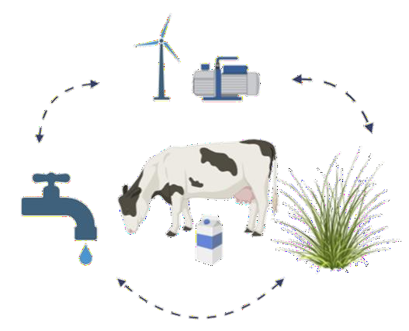
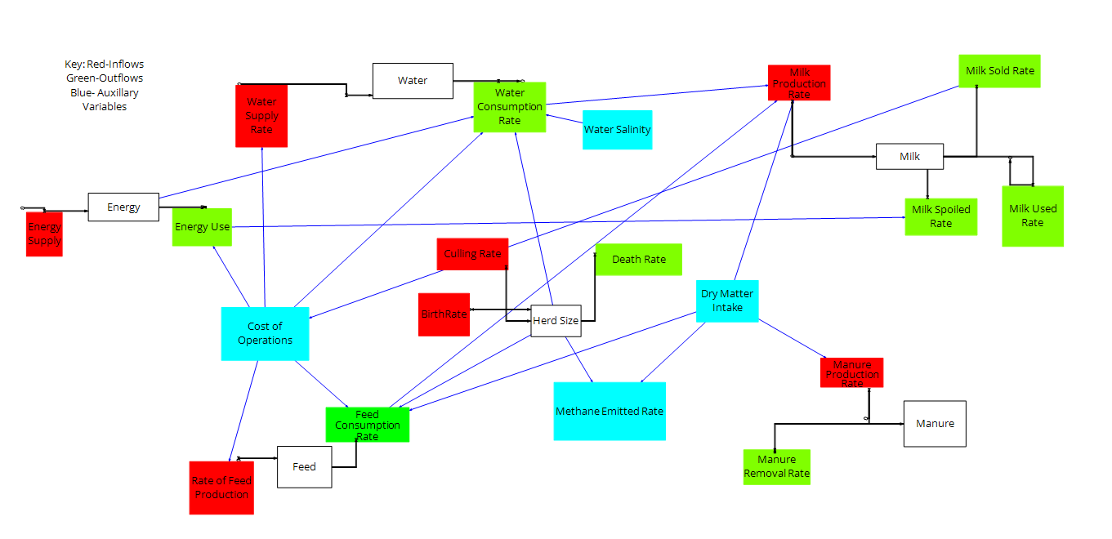


Modeling Resource Flows in Dairy Production: A Systems Dynamics Approach to the WEF Nexus
Shivam Kanodia, Rishab Prakash, Aparna Pushkaran Ajitha, Karun Kaniyamattan
Department of Animal Science, Texas A&M University¹
SUMMARY: This study develops a multi-year dynamics model of an organic dairy farm using Vensim PLE, simulating six core stocks: Herd Size, Feed Inventory, Water Storage, Energy Reserve, Milk Output, and Manure Stock. This is all within a Water-Energy-Food (WEF) nexus framework. Key auxiliary variables include Water Use Efficiency (WUE), Energy Use Efficiency (EUE), Heat Stress Factor (THI), Enteric Methane Emissions (IPCC Tier 2), and Nutrient Leaching. Baseline simulations reveal strong interdependencies across subsystems, where feed and energy availability jointly drive milk output. Future work will incorporate stress scenario testing under water scarcity, energy price shocks, and feed disruption conditions.
Dynamic hypothesis: Resource stress in any one WEF subsystem (water, feed, or energy) propagates through herd-driven feedback loops to suppress milk output, while coordinated replenishment across all three stocks stabilizes long-run farm productivity.
INTRODUCTION RESULT: CAUSAL LOOP DIAGRAM
U.S. organic dairy production faces simultaneous pressures from climate variability, input cost volatility, and growing regulatory scrutiny on environmental impact.
Energy
Raising populations - resource scarcity (Perveen et al., 2018)
Climate variability - unpredictable energy efficiency (Sejian et al., 2024)
Leads to a need for Water Energy Food Nexus (WEF) to understand resource interdependencies and find “leverage points” (Yıldız, 2021)
System dynamics modeling: visually and mathematically show behaviors of complex systems (Hülsmann et al., 2025)
MATERIALS AND METHODS
FUTURE IMPLICATIONS
Use the model to identify leverage points: small changes for large improvements
Shift to a ML focus to begin time-based modeling
Agent-based simulation to capture cow-level behavior
+
Scenario | Water Usage | Energy Usage | GHG Emissions
Technological advancements in energy efficiency | No significant change | 30% reduction | 15% reduction
Improvements in water management | 40% reduction | 5% increase | 5% reduction
Climate adaptation strategies | 25% reduction | 10% reduction | 20% reduction
6 stocks, all interconnected ultimately to herd size, showing it as the central driver of all three WEF subsystems.
The Feed → Energy → Milk production chain captures the core biological pathway of organic dairy systems, where DMI is converted into net energy for lactation (NEL), determining milk output.
Water is the most independent, and therefore vulnerable stock in the diagram, making it a primary test case for stress-scenario testing.
+
+

Slide 2
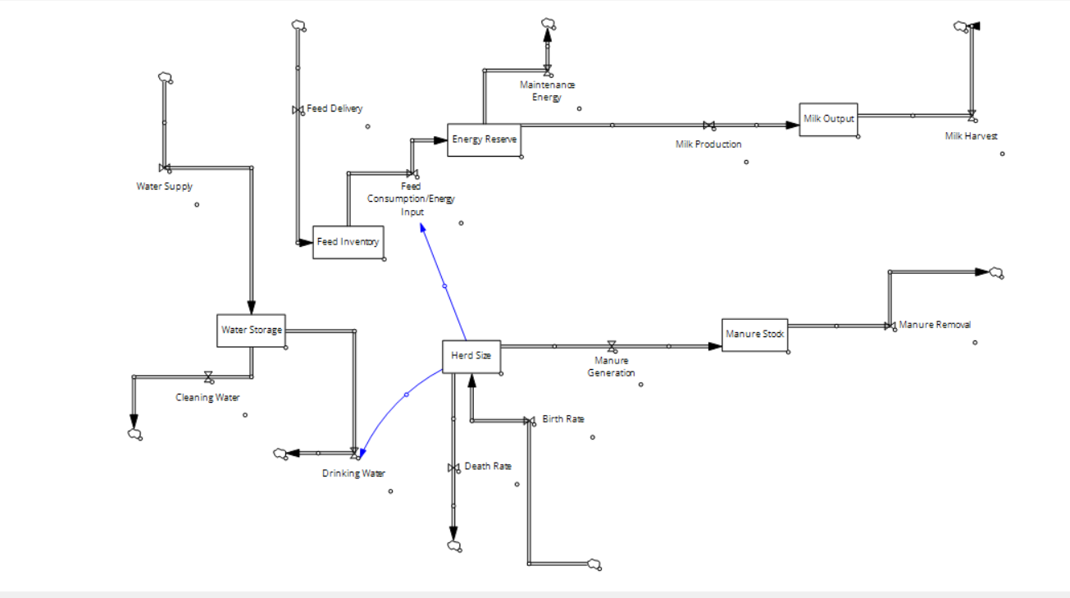
Modeling Resource Flows in Dairy Production: A Systems Dynamics Approach to the WEF Nexus
Shivam Kanodia, Rishab Prakash, Aparna Pushkaran Ajitha, Karun Kaniyamattan
Department of Animal Science, Texas A&M University¹
SUMMARY: This study develops a multi-year dynamics model of an organic dairy farm using Vensim PLE, simulating six core stocks: Herd Size, Feed Inventory, Water Storage, Energy Reserve, Milk Output, and Manure Stock. This is all within a Water-Energy-Food (WEF) nexus framework. Key auxiliary variables include Water Use Efficiency (WUE), Energy Use Efficiency (EUE), Heat Stress Factor (THI), Enteric Methane Emissions (IPCC Tier 2), and Nutrient Leaching. Baseline simulations reveal strong interdependencies across subsystems, where feed and energy availability jointly drive milk output. Future work will incorporate stress scenario testing under water scarcity, energy price shocks, and feed disruption conditions.
Dynamic hypothesis: Resource stress in any one WEF subsystem (water, feed, or energy) propagates through herd-driven feedback loops to suppress milk output, while coordinated replenishment across all three stocks stabilizes long-run farm productivity.
INTRODUCTION RESULT: CAUSAL LOOP DIAGRAM
U.S. organic dairy production faces simultaneous pressures from climate variability, input cost volatility, and growing regulatory scrutiny on environmental impact.
Energy
Raising populations - resource scarcity (Perveen et al., 2018)
Climate variability - unpredictable energy efficiency (Sejian et al., 2024)
Leads to a need for Water Energy Food Nexus (WEF) to understand resource interdependencies and find “leverage points” (Yıldız, 2021)
System dynamics modeling: visually and mathematically show behaviors of complex systems (Hülsmann et al., 2025)
MATERIALS AND METHODS
FUTURE IMPLICATIONS
Use the model to identify leverage points: small changes for large improvements
Shift to a ML focus to begin time-based modeling
Agent-based simulation to capture cow-level behavior
+
Scenario | Water Usage | Energy Usage | GHG Emissions
Technological advancements in energy efficiency | No significant change | 30% reduction | 15% reduction
Improvements in water management | 40% reduction | 5% increase | 5% reduction
Climate adaptation strategies | 25% reduction | 10% reduction | 20% reduction
6 stocks, all interconnected ultimately to herd size, showing it as the central driver of all three WEF subsystems.
The Feed → Energy → Milk production chain captures the core biological pathway of organic dairy systems, where DMI is converted into net energy for lactation (NEL), determining milk output.
Water is the most independent, and therefore vulnerable stock in the diagram, making it a primary test case for stress-scenario testing.
+
+
REFERENCES
+
+
+
Table 1: Hypothetical scenario analysis

